Slide 1
STACK

Slide 2
Linear Data Structures
Lists
Stack
Queue

Slide 3
Non-linear data structures
Binary Search Tree
Heap
Graph

Slide 4
Stack
Basically store and retrieve data from the queue which implements a last-in-first-out queueing discipline.
Create our own stack implementation.
Operations:
push() – add an item to the stack
pop() – remove the topmost item from the stack
peek() – look at, but do not modify, the top item in the stack

Slide 5


Calculations using reverse polish notation

Slide 6




Reversing a string

Slide 7
Check for palindrome
2002
1991
amanaplanacanalpanama

Slide 8

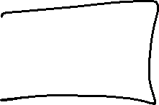




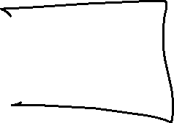

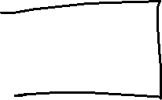






Slide 9



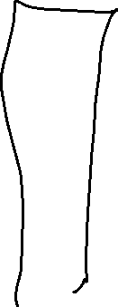


Build a stack using an array

Slide 10
Build a stack using an array

Slide 11

Build a stack using a static array

Slide 12
Build a stack using an array

Slide 13

Build a stack using an array

Slide 14
Build a stack using an array

Slide 15




Stack using a linked structure

Slide 16

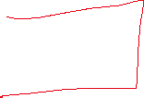
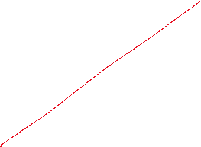

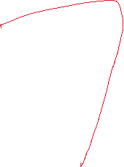




Slide 17
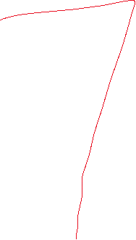





Slide 18


Slide 19





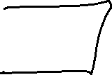


Slide 20






